Slide 1
— Wominjeka (Welcome)
Assessment 2 Guide
BUSM4448
Notes:
Wominjeka.
Welcome to Business Research Design.
This is the recording of week 5 lecture.

Slide 2
Notes:
Before I begin with the week’s agenda allow me to say a few words for the acknowledgment of the country.

Slide 3

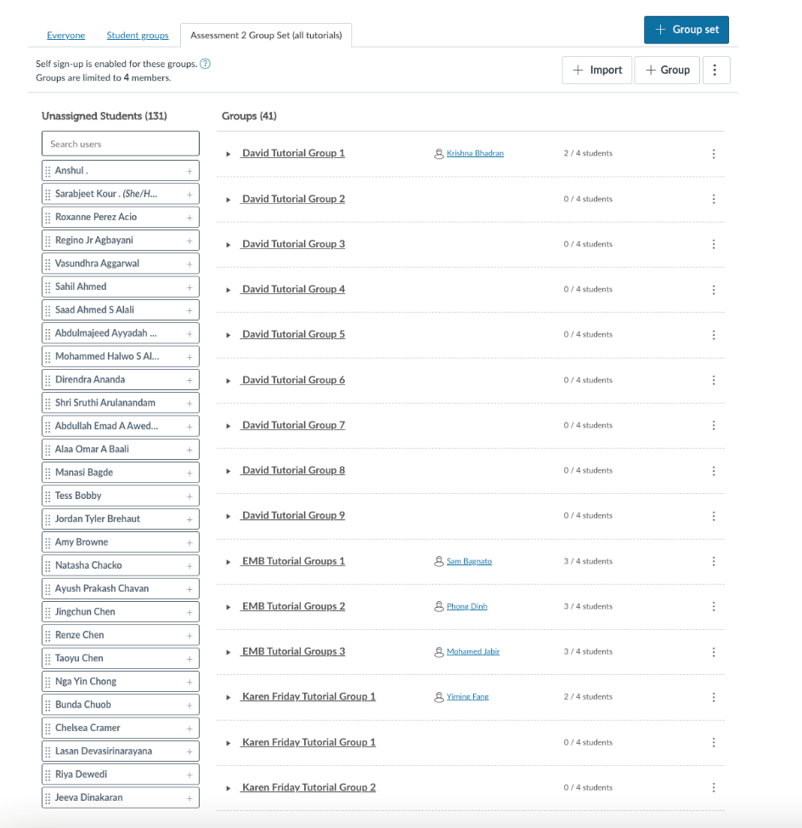
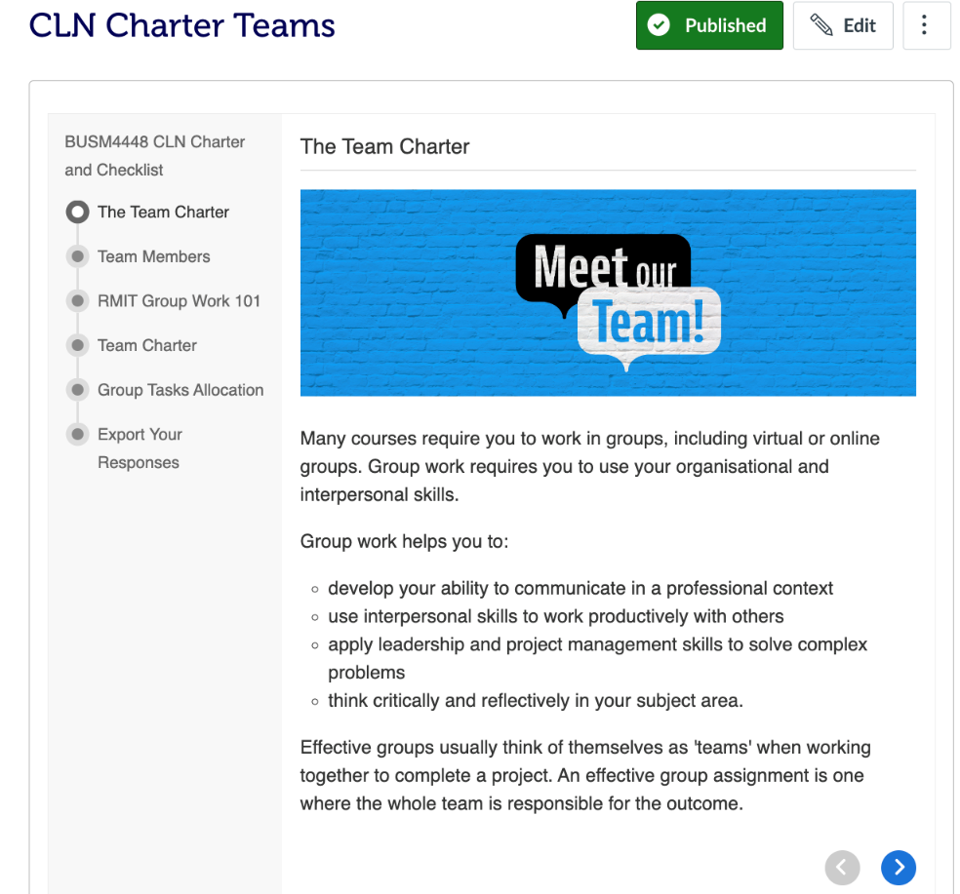
Group Formation
Maximum 5 per team

Slide 4
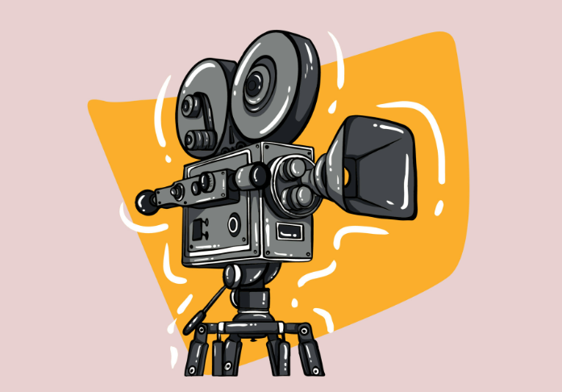
Let’s Start with the Basics
1- Team Dynamics
2- Extension Protocols
3- Presentation Expectations
4- Miro – get on and use.
5- UN SDGs
Let’s look at 5 tips for presenting online! 5:30
https://youtu.be/XyRjKCT_wrk

Slide 5
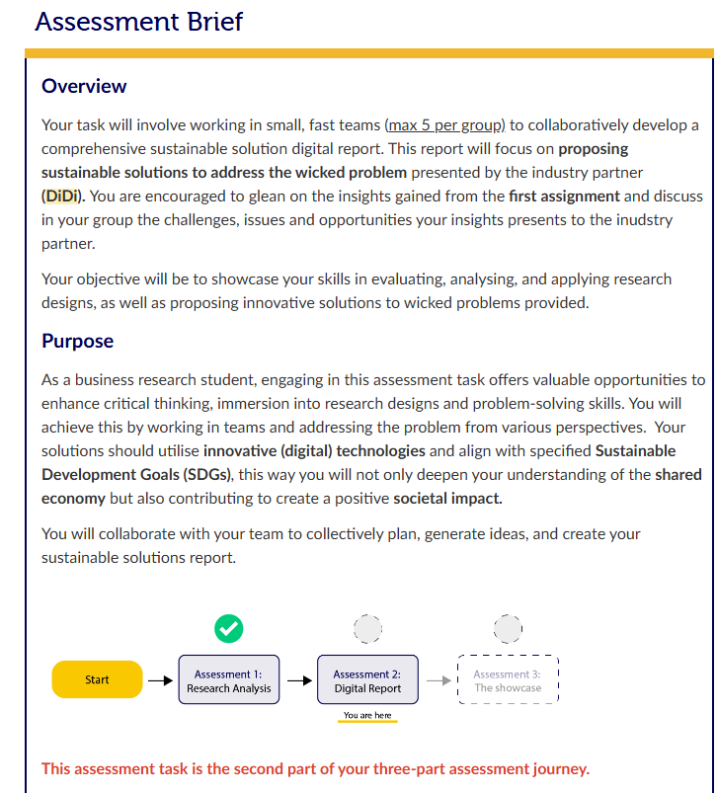

Slide 6
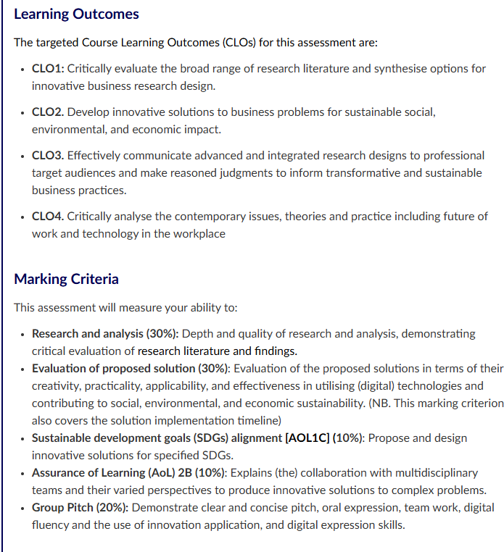

Slide 7
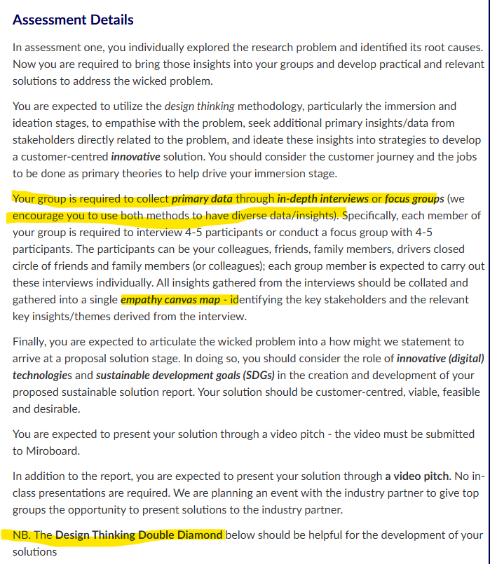

Slide 8
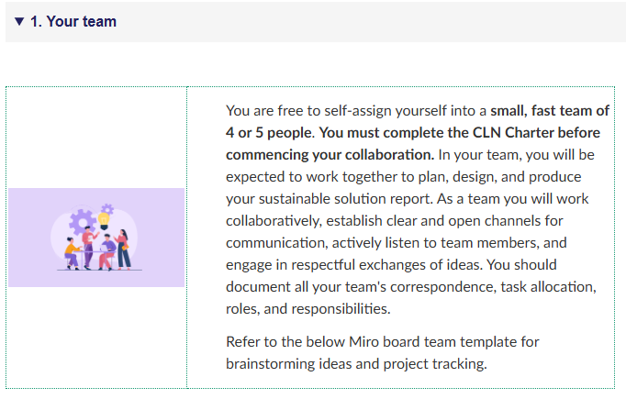

Slide 9
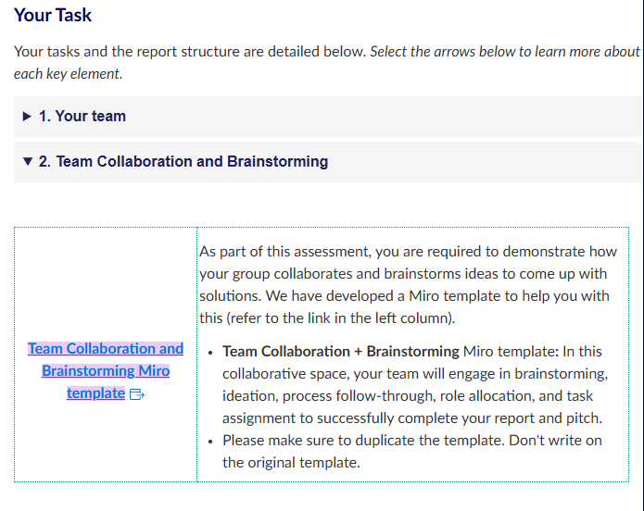

Slide 10
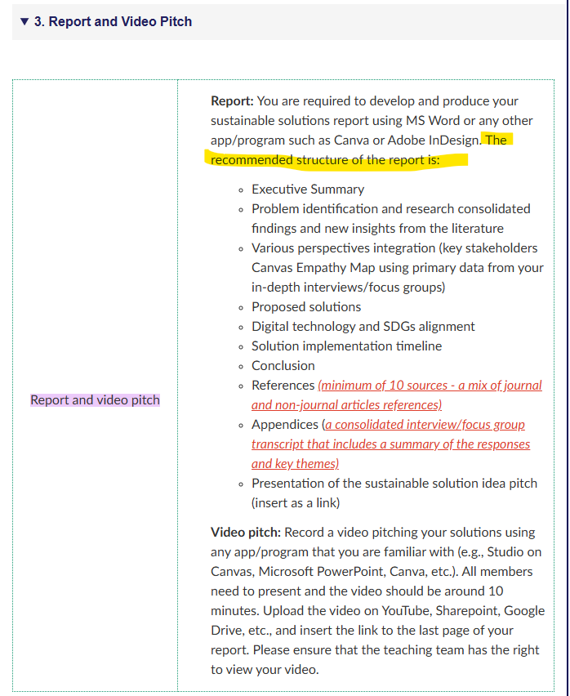

Slide 11
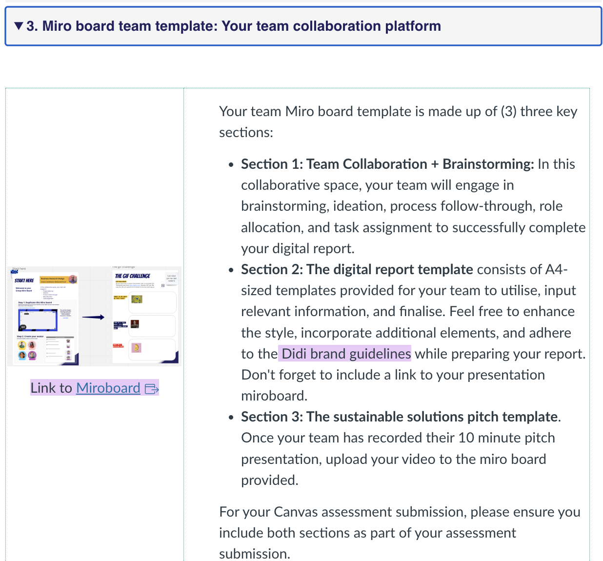
Assessment 2
Miroboard

Slide 12
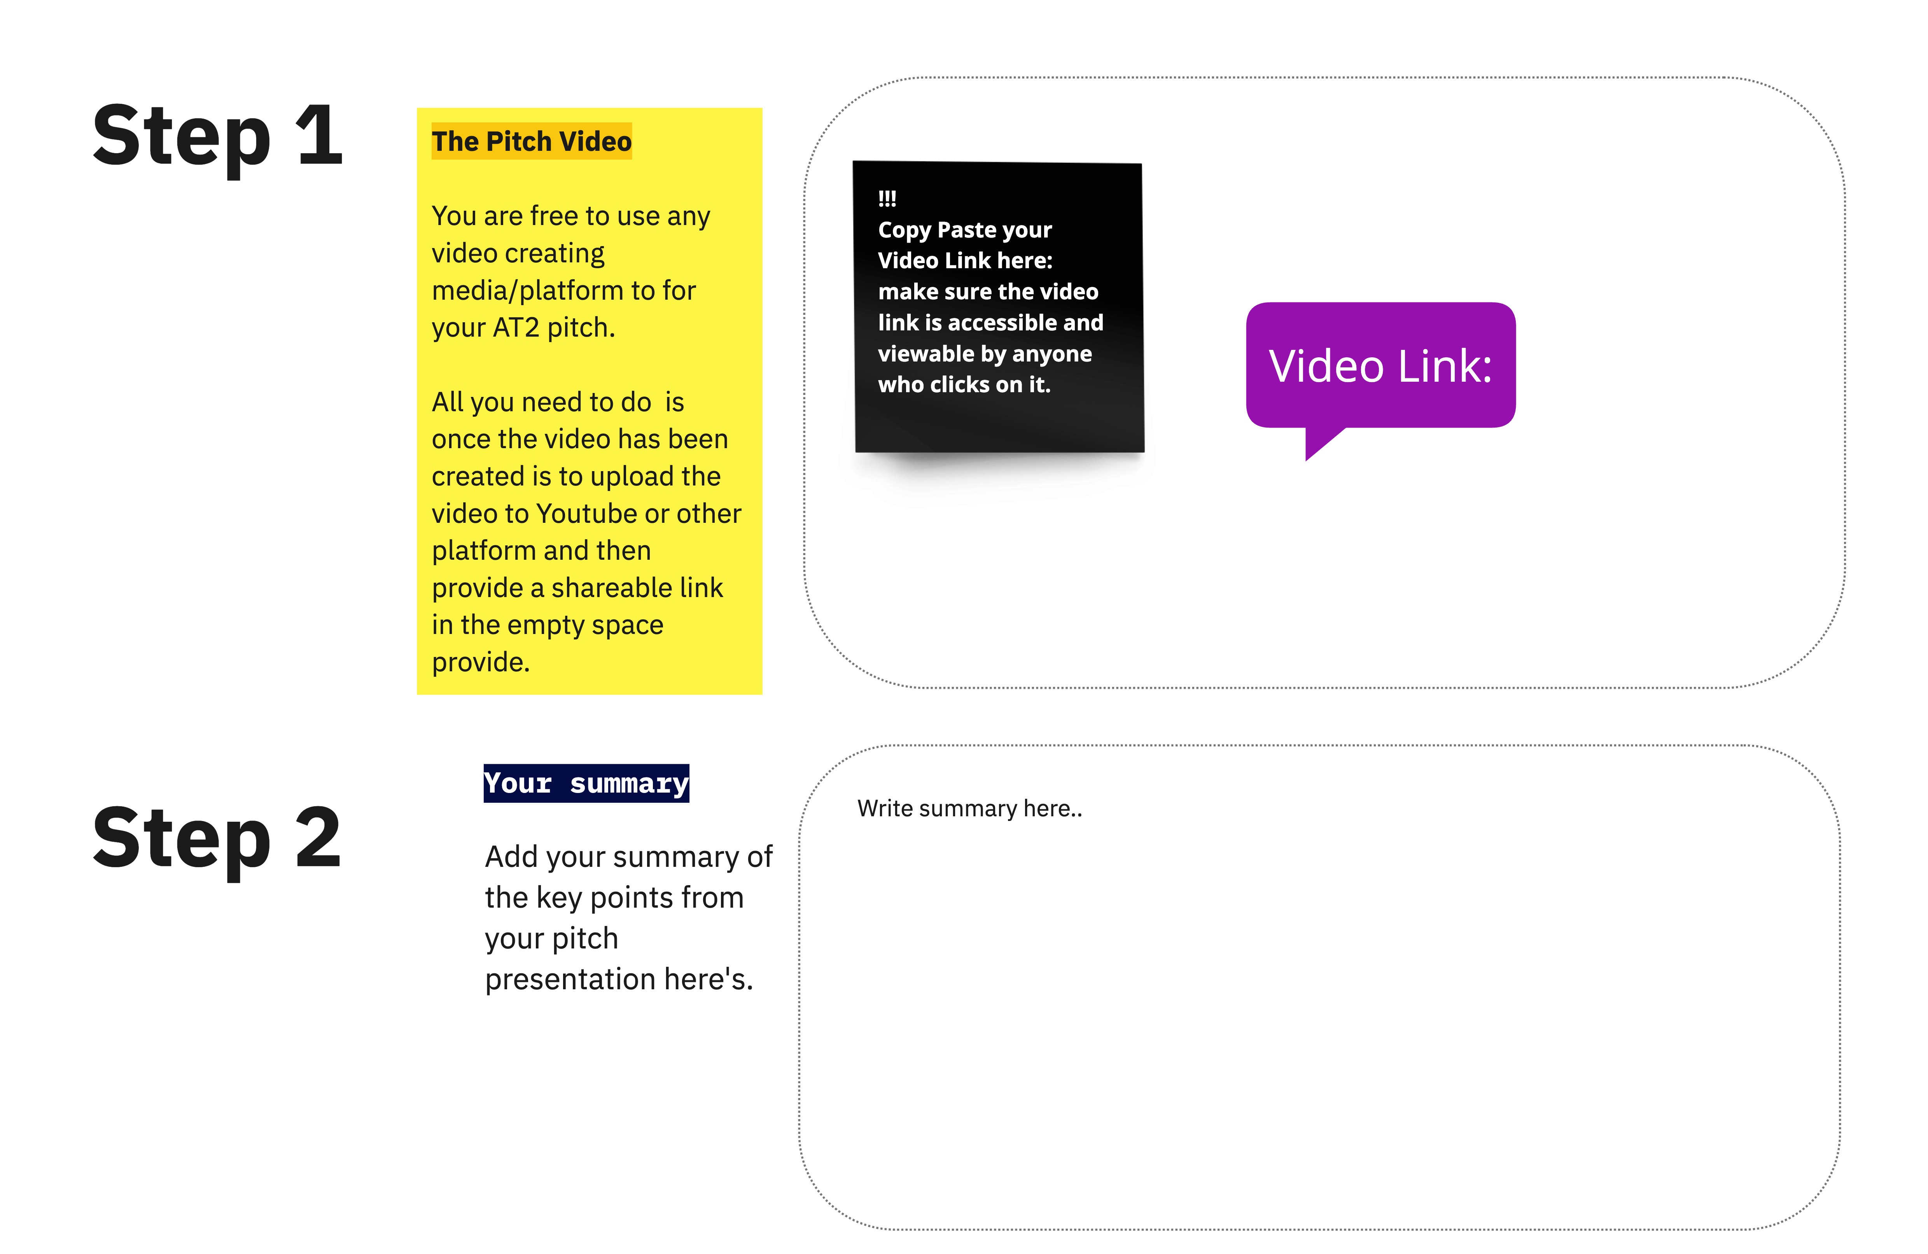
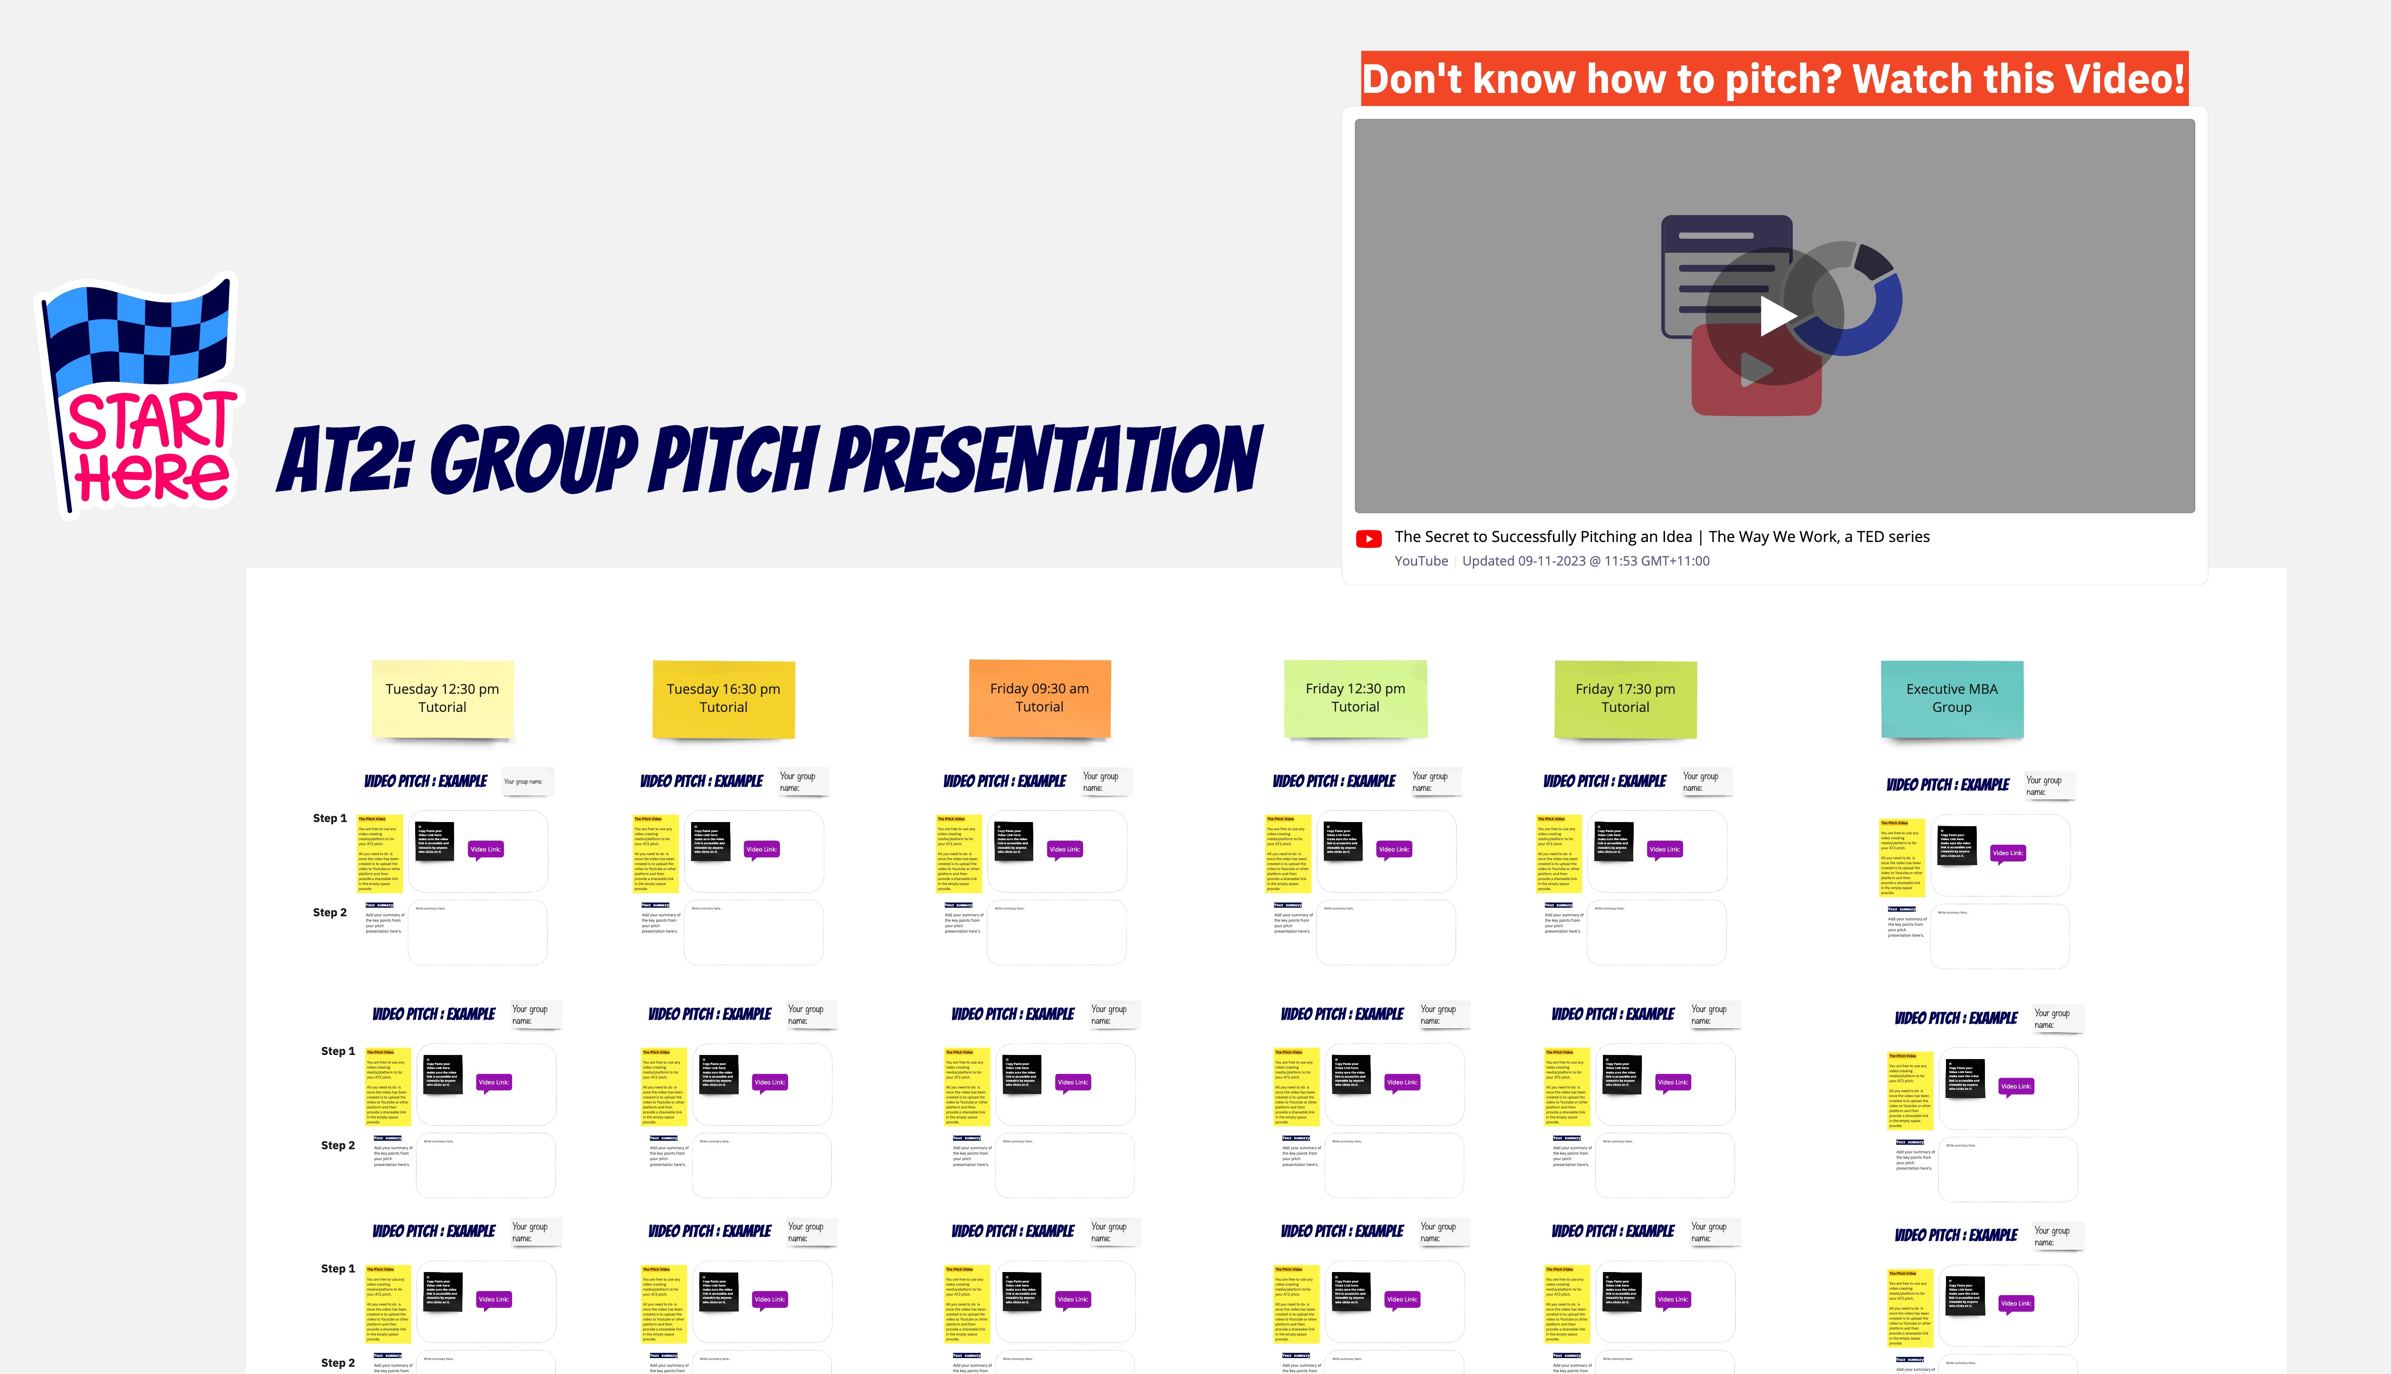
Assessment 2 Group Pitch

Slide 13
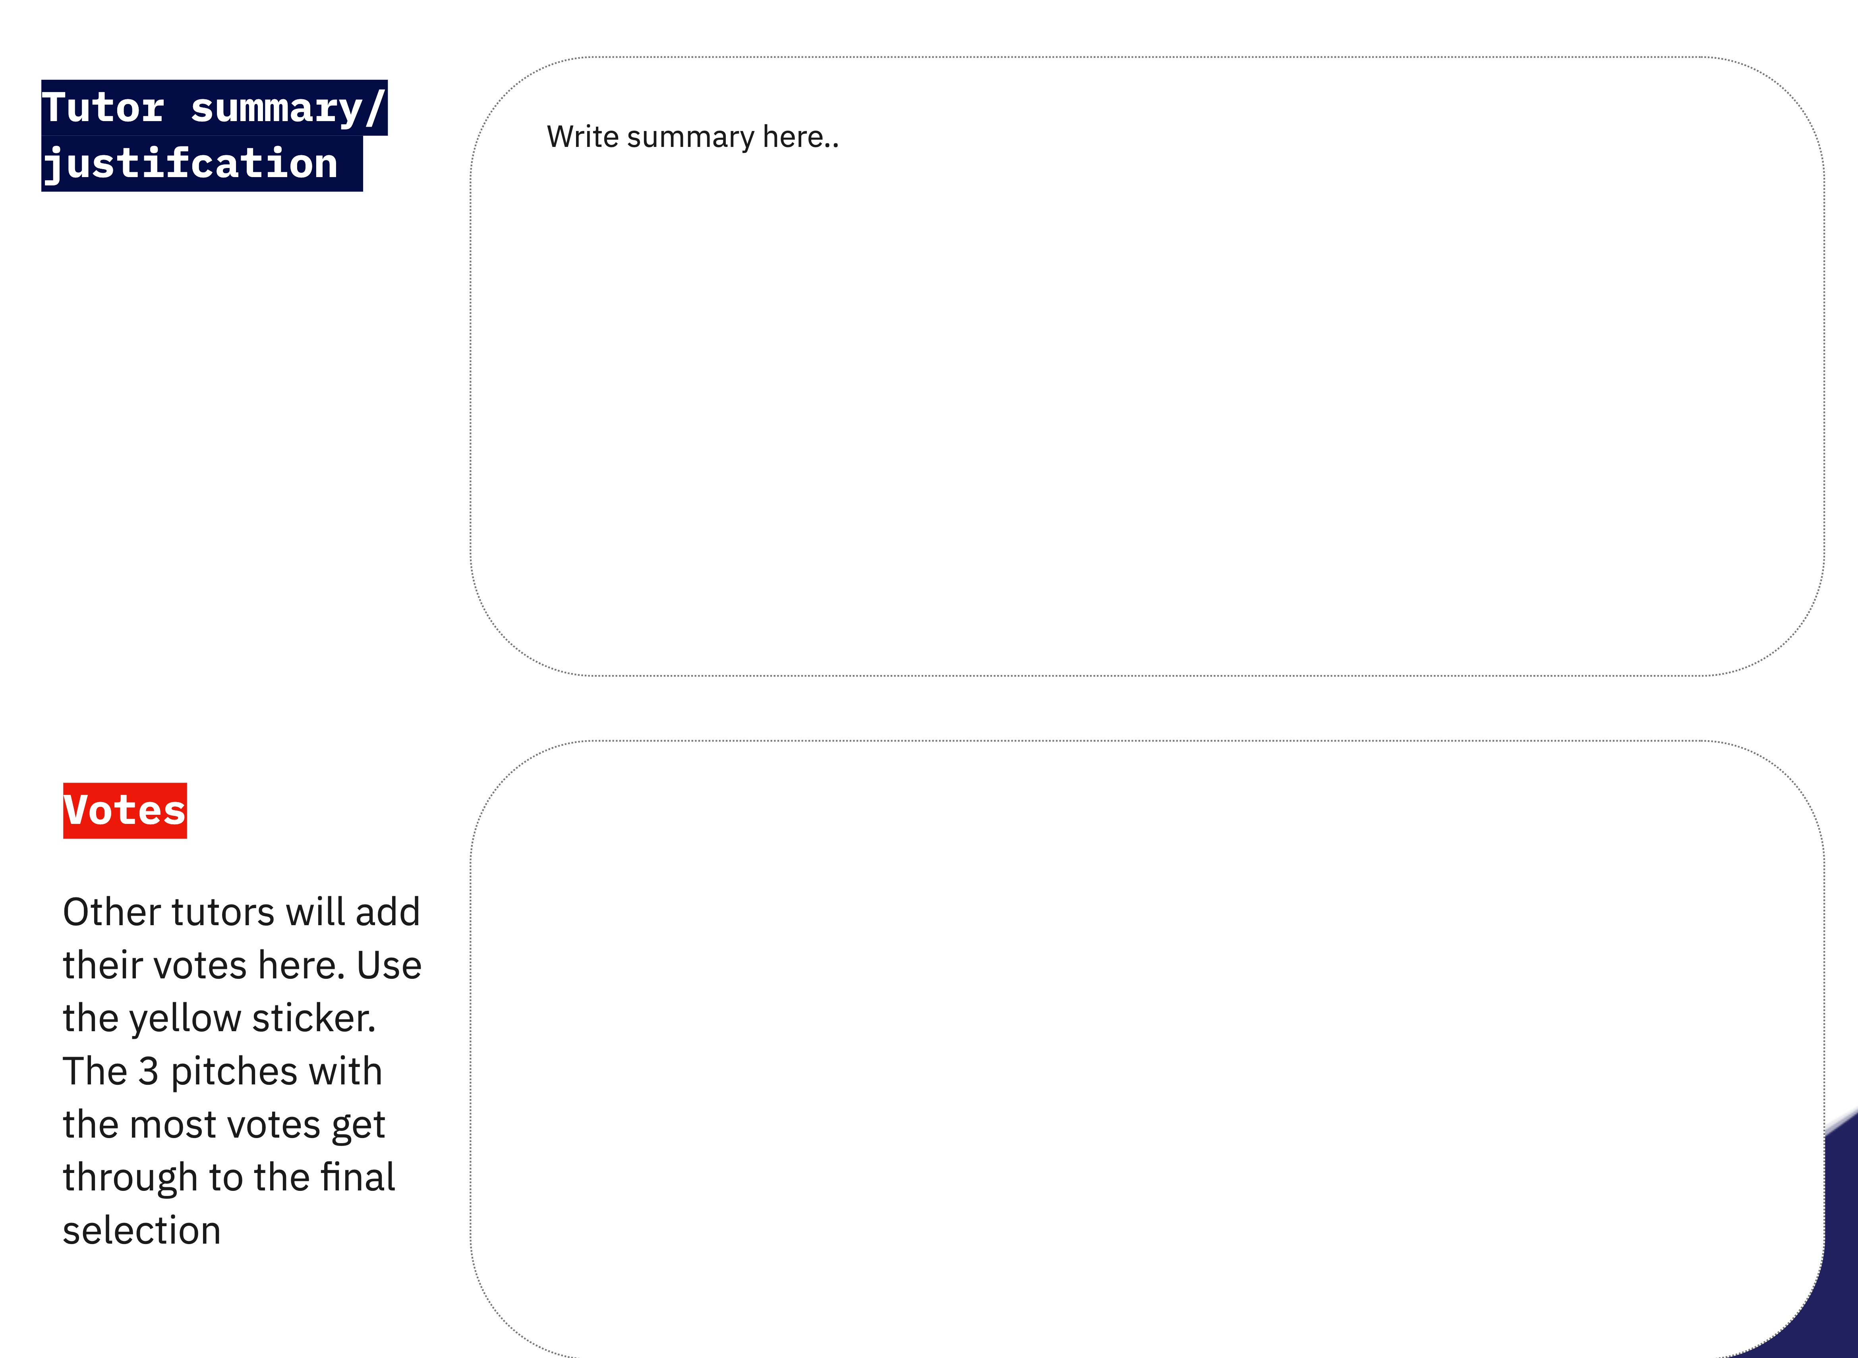
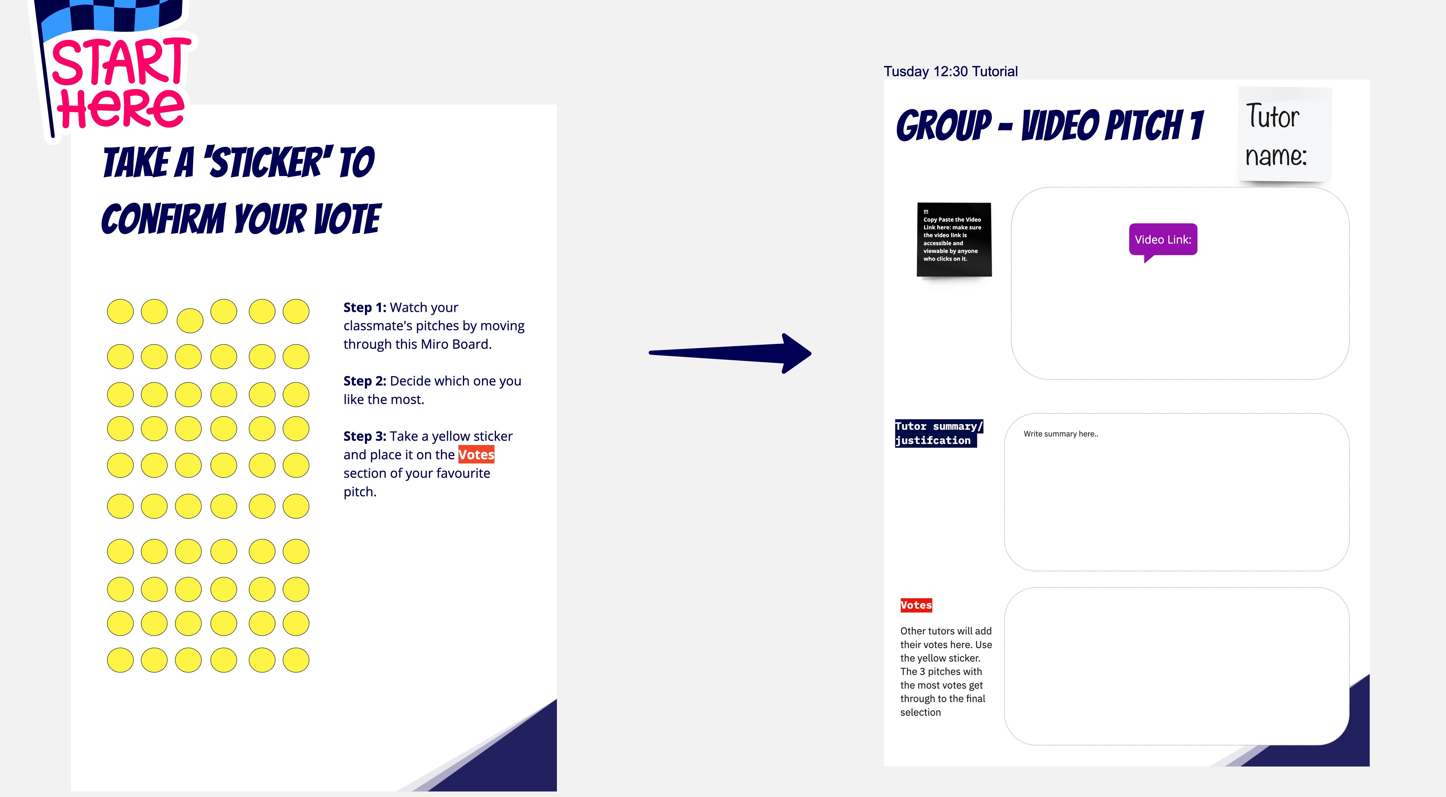
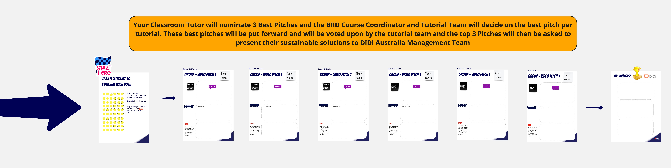
Best Pitch Voting Process

Slide 14
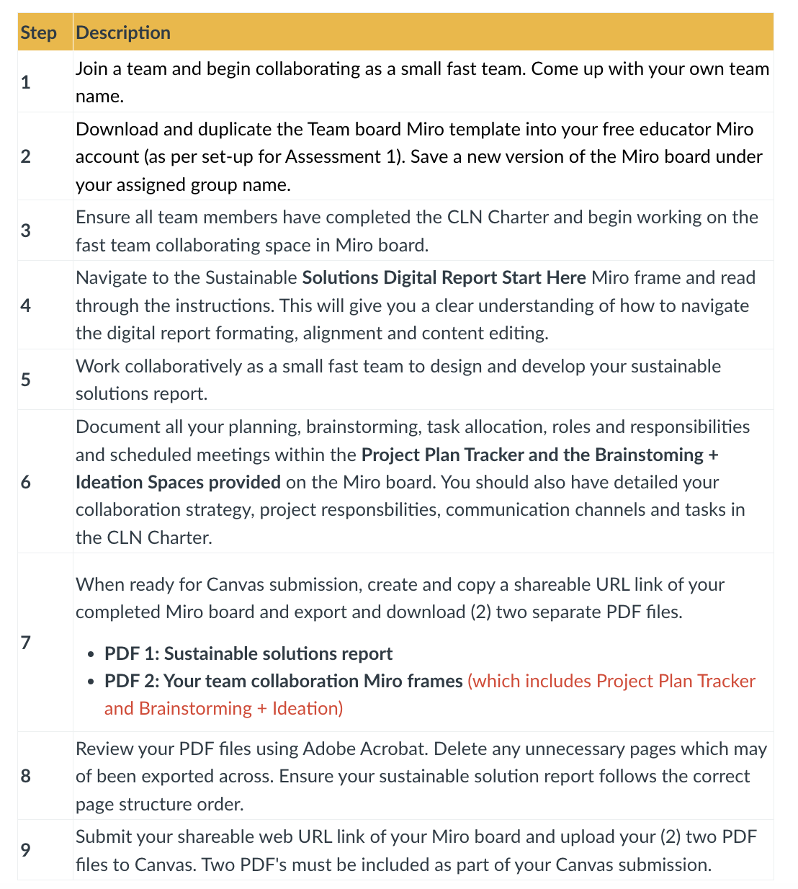
Submission details
You will be required to electronically submit the following on Canvas using the Assessment 2 submission link:
PDF 1: Sustainable solutions report
PDF 2: Your team's collaboration Miro frames (which includes Project Plan Tracker and Brainstorming + Ideation)
Web URL link of all Miro board used for this assessment task.
Please follow the file naming conventions of teacher assigned Group Name_Assessment 2.
Ensure all team members names and student numbers are on each PDF file and your team's Miro board.

Slide 15
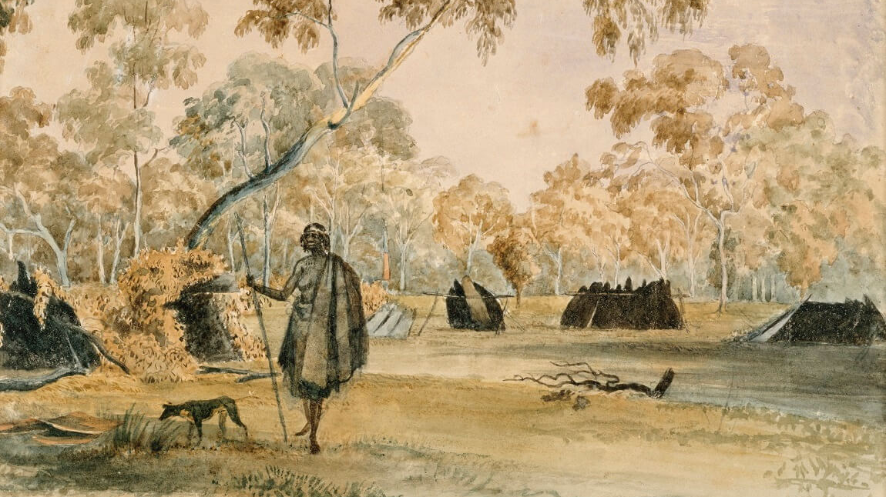
Noon Gudgin
Thank you

